Slide 1


Gabriel Bessette
17.12.1998

Slide 2

Outline
Executive Summary
Introduction
Methodology
Results
Conclusion
Appendix

Slide 3
Executive Summary
Methodologies
Data extraction (API/Web-scraping) of Falcon F9 launches & landings
Data manipulation and EDA (SQL/Pandas)
Interactive data visualization (Folium/Plotly/Dash)
Predictive analysis using classification models (Scikit-learn)
Results
Payload mass and success rate (2010-2020)
Best performing orbit type
Launch sites’ locations
Best performing launch site
Best performing booster version
Best classification model

Slide 4
Introduction
Project background and context
Reduced costs in space exploration are mainly due to reusability of rocket launchers
Hence the cost of a SpaceX Flacon 9 is only 62M$ compared to 165M$ for other providers
However, this cost is dependent on the success/failure rate of the operations
Project’s aim:
Predict if Falcon 9 will land successfully,
by using available records of past rocket launches (2010-2020)

Slide 5

Section 1

Slide 6
Methodology
Executive Summary
Data collection methodology:
Collect data from SpaceX data base using REST API
Collect data from Falcon F9 launches from Wikipedia tables using Web-scraping
Perform data wrangling
Cleaning data and classifying data for successful landings
Perform exploratory data analysis (EDA) using visualization and SQL
Perform interactive visual analytics using Folium and Plotly Dash
Perform predictive analysis using classification models
Building, tuning, and evaluating classification models (Logreg, SVM, Tree, KNN) using cross-validation, and grid search for hyper-parameter optimization

Slide 7
Data Collection
Data sets on Falcon F9 launches have been collected using two methods:
Data Collection
SpaceX REST
API
Wikipedia
Web-scraping

Slide 8
Data Collection – SpaceX API
SpaceX REST calls URL API_url
Dataset information
Categorical
Date, Booster version, Orbit type, Launch site, Launch Outcome, Grid fins, Reused booster, Legs, Landing pad, Serial number
Numerical
Flight number, Payload mass, Number of flights, Block, Reused count, Longitude, Latitude
Add the GitHub URL of the completed SpaceX API calls notebook
Main API call
Get request .json file
Store data into DataFrame
Additional API calls
Adjust table values
Clean data / Missing Values

Slide 9
Data Collection - Scraping
Web scraping URL webscraping_url
Dataset information
Categorical
Date, Time, Booster version, Payload, Orbit type, Launch site, Launch Outcome, Customer, Landing Outcome
Numerical
Flight number, Payload mass
Add the GitHub URL of the completed web scraping notebook
Wikipedia web scraping
Request HTML page
Create BeautifulSoup object from HTTP response
Create DataFrame by
parsing tables and cleaning

Slide 10
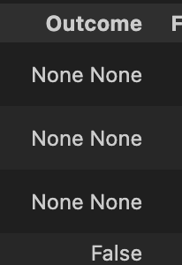
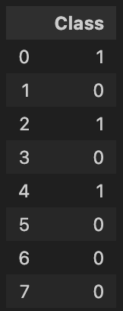
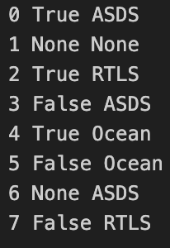
Data Wrangling
Constructing labels for (un)successful Falcon 9 landings
Add the GitHub URL of your completed data wrangling related notebooks
Differentiate good from bad landing outcomes from a set of features
Create a new column of flags for successful (1) /unsuccessful (0) landing outcomes
Dataset

Slide 11
EDA with Data Visualization
Influence of Flight Number, Payload Mass, and Launch Site on successful/failing landings
Evolution of landings’ success rate from 2010 to 2020
Add the GitHub URL of your completed EDA with data visualization notebook, as an external reference and peer-review purpose
Influence of Orbit Type, Flight Number and Payload Mass on successful/failing landings
Payload Mass (kg) vs Flight Number
Launch Site vs Flight Number
Launch Site vs Payload Mass (kg)
Success Rate vs Orbit Type
Orbit Type vs Flight Number
Orbit Type vs Payload Mass (kg)
Add the GitHub URL of your completed data wrangling related notebooks
Success Rate vs Year

Slide 12
EDA with SQL
Summary of the SQL queries
Display the names of the unique launch sites in the space mission
Display 5 records where launch sites begin with the string 'CCA'
Display the total payload mass carried by boosters launched by NASA (CRS)
Display average payload mass carried by booster version F9 v1.1
List the date when the first succesful landing outcome in ground pad was acheived.
List the names of the boosters which have success in drone ship and have payload mass greater than 4000 but less than 6000
List the total number of successful and failure mission outcomes
List the names of the booster_versions which have carried the maximum payload mass. Use a subquery
List the records which will display the month names, failure landing_outcomes in drone ship ,booster versions, launch_site for the months in year 2015
Rank the count of landing outcomes (such as Failure (drone ship) or Success (ground pad)) between the date 2010-06-04 and 2017-03-20, in descending order
Add the GitHub URL of your completed EDA with SQL notebook, as an external reference and peer-review purpose

Slide 13
Build an Interactive Map with Folium
Spotting SpaceX launch sites on USA map:
Marking launch sites on map using Circles and Markers
Marking success/failure landings for each site on map using MarkerCluster:
Specify green color for successful landings and red color for unsuccessful landings
Study the distances between a launch site to its proximities
Specifying the distances between a launch site to its proximities using Lines and distance value using Markers
Add the GitHub URL of your completed interactive map with Folium map, as an external reference and peer-review purpose

Slide 14
Build a Dashboard with Plotly Dash
Summary of Graphs
Pie chart: specify proportion of successful launches for each launch site
Scatter plot : determine the correlation between Payload Mass and Launch Success Rate for each Falcon 9 booster version
Summary of Interactions
Markdown for selection of specific launch site (including “all sites”), applied to both graphs
Payload mass range slider for scatter plot to differentiate heavy from light launches
Add the GitHub URL of your completed Plotly Dash lab, as an external reference and peer-review purpose

Slide 15
Predictive Analysis (Classification)
Model development process
Types of Models Studied
Separate success/failure labels from input (all other features)
Logistic Regression
Support Vector Machines
Decision Tree
K Nearest Neighbors
Normalise input
Split labels and inputs into training (80%) and testing sets (20%)
Train each model for different hyper-parameters and using cross-correlation
Add the GitHub URL of your completed predictive analysis lab, as an external reference and peer-review purpose
Evaluate and compare best models on test set using the accuracy metric

Slide 16
Results
Exploratory data analysis results
Interactive analytics demo in screenshots
Predictive analysis results

Slide 17

Section 2

Slide 18
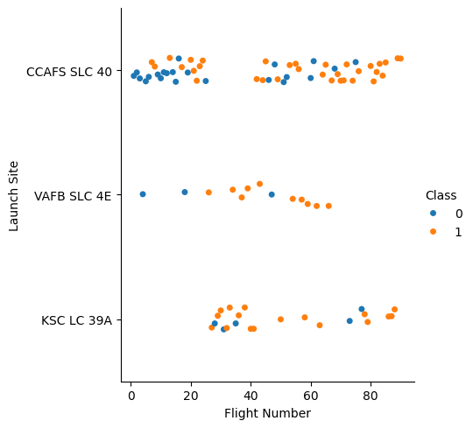
Flight Number vs. Launch Site
Most of the 20 first launches departed from CCAFS site
Rockets launched from CCAFS mostly failed to land during the first tests (for low FN). However, the scatter plot indicates less and less failure throughout the years, as the FN increases.
This tendency can also be observed for other launch sites, such as VAFB and KSC.

Slide 19
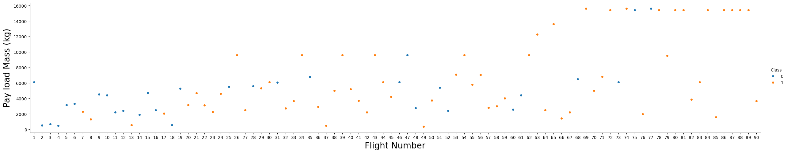
Payload vs. Launch Site
Throughout the years, heavy launchers (high payload mass) outnumber lightweight launchers
Success rate increases with FN

Slide 20
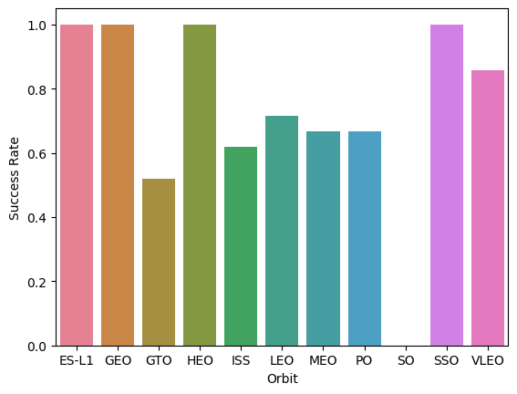
Success Rate vs. Orbit Type
Orbit types ES-L1, GEO, HEO, SSO and VLEO show highest success rate, above 80%.
The average success rate for all other orbits is around 60%, except for the SO orbit which shows 0% success rate (outlier).

Slide 21
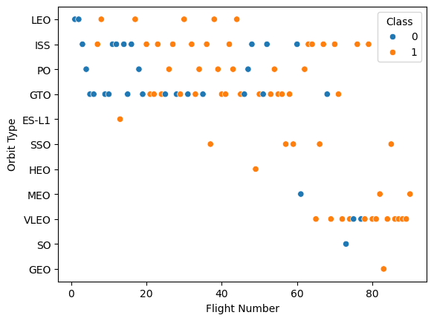
Flight Number vs. Orbit Type
Data is not representative for the ES-L1, HEO, GEO and SO orbits, since only 1 test was attempted on these orbits.
For all other orbit types, we observe a progression in success rate throughout the years (or FN).
Note that SSO orbit shows 100% accuracy for more than 1 attempt.

Slide 22
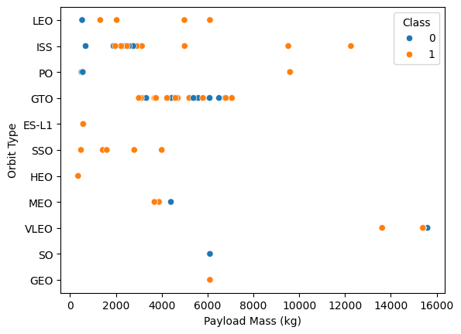
Payload vs. Orbit Type
From the scatter plot, most of the payload carried by the F9 is below 10’000 (kg)
Except for the ISS orbit, each orbit type seems to have a small payload range

Slide 23
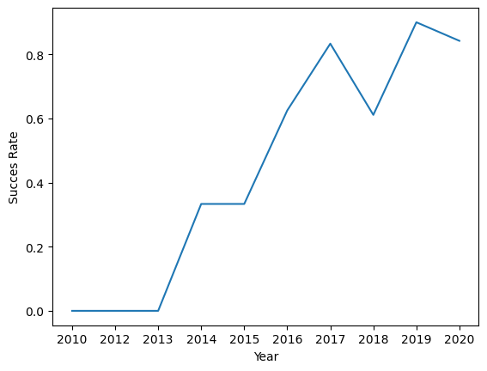
Launch Success Yearly Trend
Success rate clearly increases throughout the years
A small drop in success rate occurs in 2018, while the general tendency for the success rate is increasing with the years

Slide 24
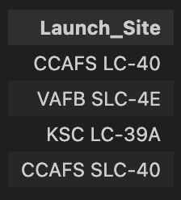
All Launch Site Names
Names of the unique launch sites
Falcon 9 launchers have been launched from 4 different sites from 2010 to 2020

Slide 25
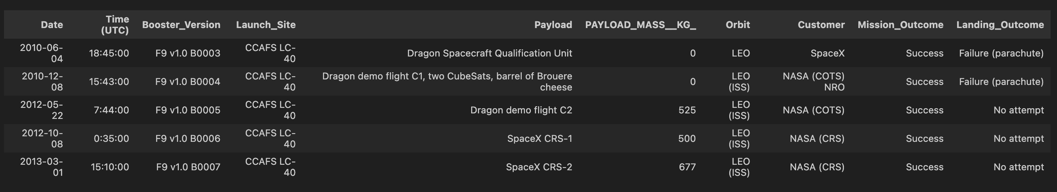
Launch Site Names Begin with 'CCA'
The landing phase of the boosters at CCAFS resulted in either failure or no attempt

Slide 26
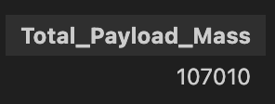
Total Payload Mass
Total payload mass (kg) carried by Falcon 9 boosters from NASA (2010-2020)
Although Falcon 9 is a SpaceX booster, NASA benefitted from this booster to send some payload into space

Slide 27
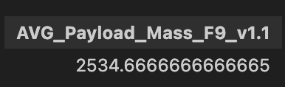
Average Payload Mass by F9 v1.1
Average payload mass (kg) carried by booster version F9 v1.1 (2010-2020)
Typical weight carried by a F9 v1.1 booster

Slide 28
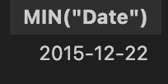
First Successful Ground Landing Date
Although tests started in 2010, it took 5 years for boosters to successfully land on a ground pad!

Slide 29
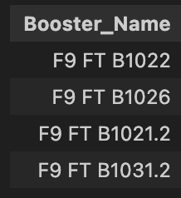
Successful Drone Ship Landing with Payload between 4000 and 6000
Boosters which have successfully landed on drone ship and had payload mass greater than 4000 but less than 6000

Slide 30
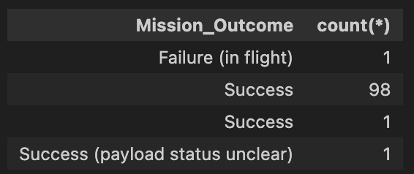
Total Number of Successful and Failure Mission Outcomes
Missions only failed once
The payload status was unclear only once
Else, every mission was a success!

Slide 31
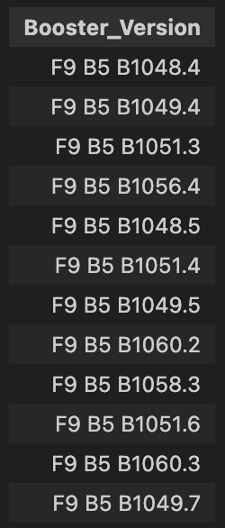
Boosters Carried Maximum Payload
The F9 B5 is one of the biggest boosters from SpaceX F9 series
It carried the maximum payload to space

Slide 32
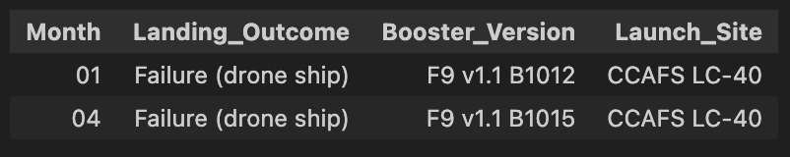
2015 Launch Records
Failed landing outcomes in drone ship, their booster versions, and launch site names for year 2015
F9 v1.1 failed twice to land on drone ship when launched from CCAFS

Slide 33
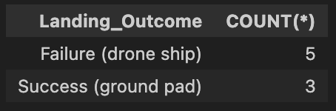
Rank Landing Outcomes Between 2010-06-04 and 2017-03-20
There is more failure on drone ships than success on ground pads between 2010-06-04 and 2017-03-20.

Slide 34

Section 3

Slide 35
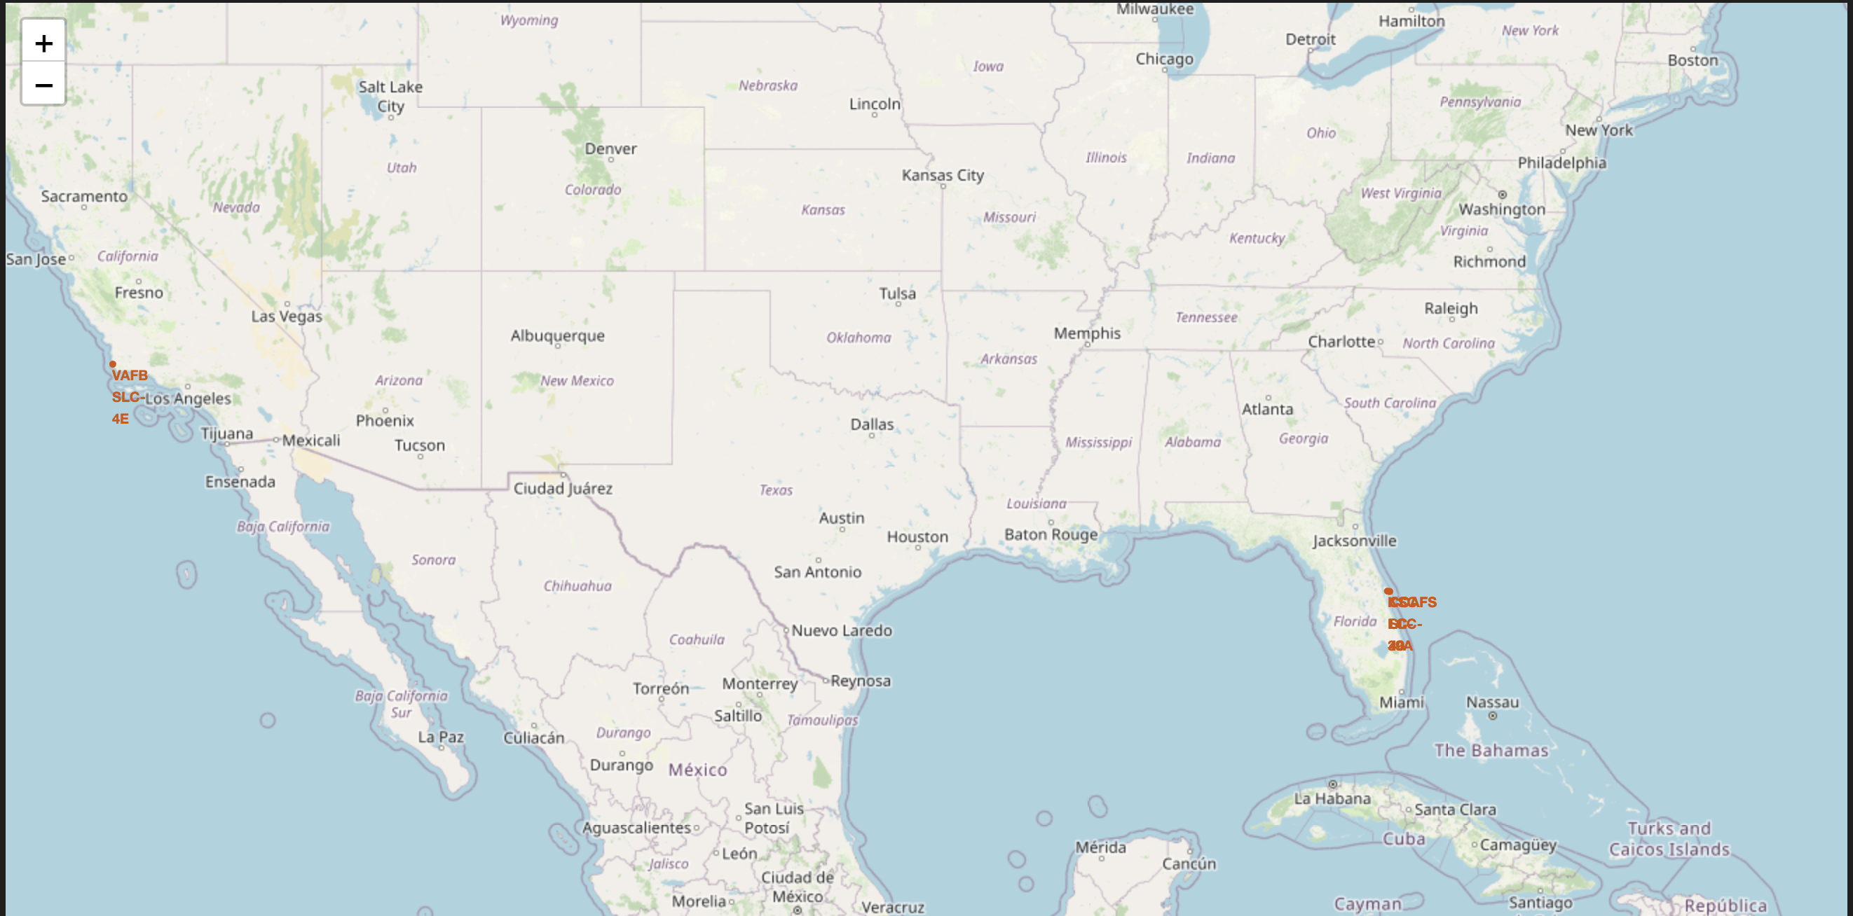
Launch Sites Location
Launch sites are located close to the equator on the east or west coast of the USA

Slide 36
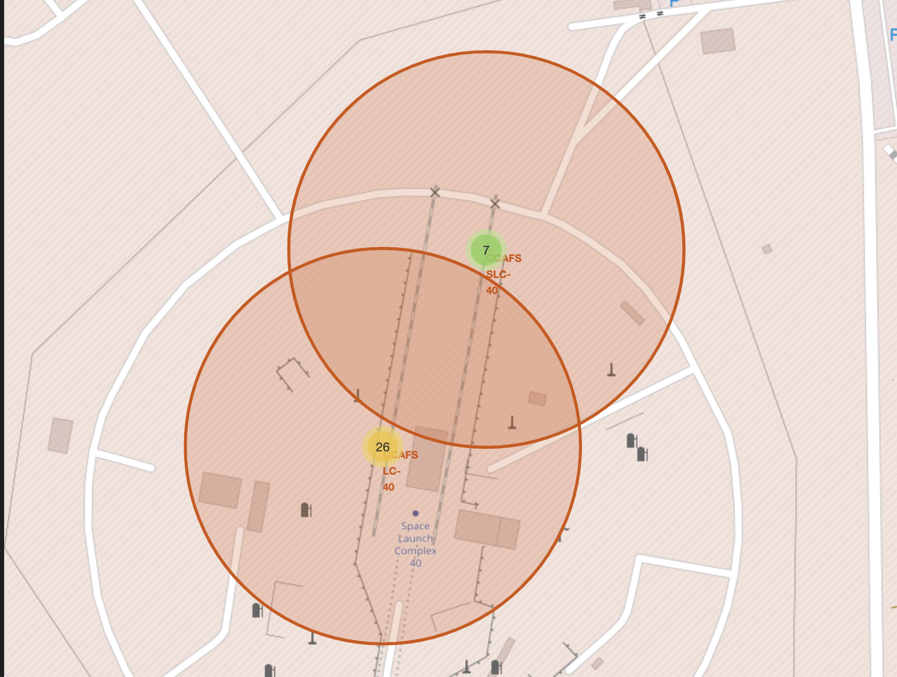
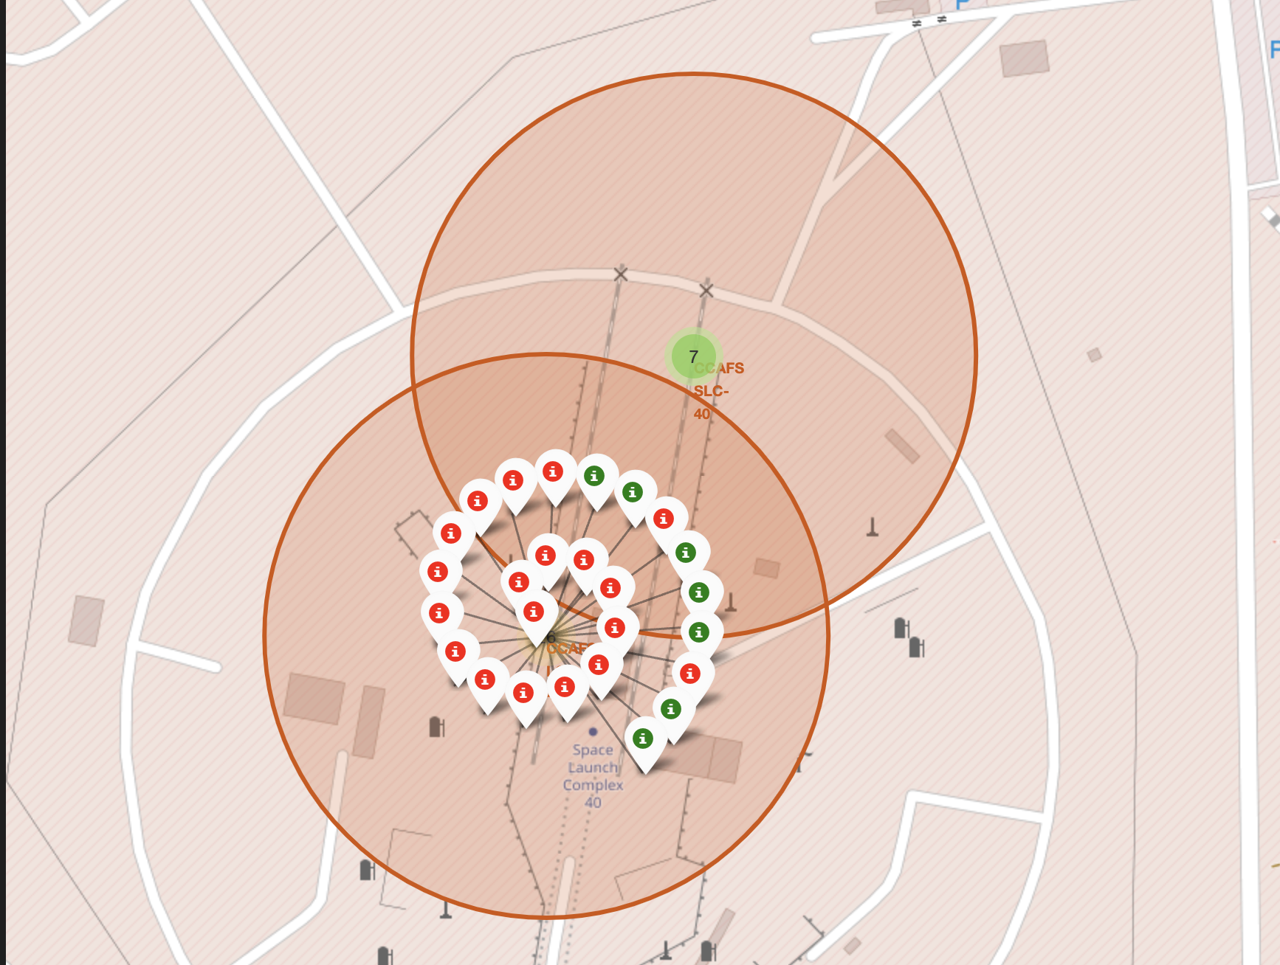
Launch Outcomes on CCAFS Sites
Launch outcomes indicated as grouped markers: green (success), red (failure)

Slide 37
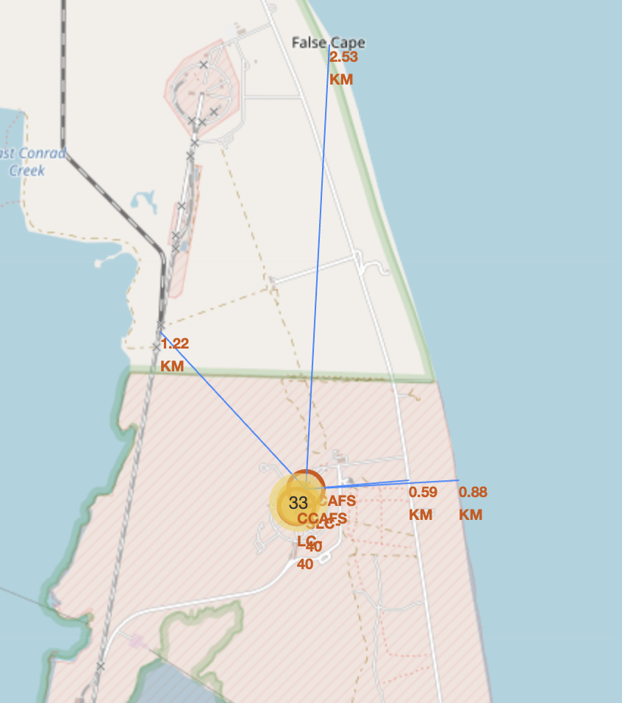
CCAFS Launch Site and Distance to its Proximities
CCAFS launch sites are located at less than 1km from the coastline for safety purposes.
CCAFS launch sites are well connected to railways (1.22km) and highways (0.59km) for better logistics.
Surprisingly, the closest city is only 2.5km away from the launch sites.

Slide 38

Section 4

Slide 39
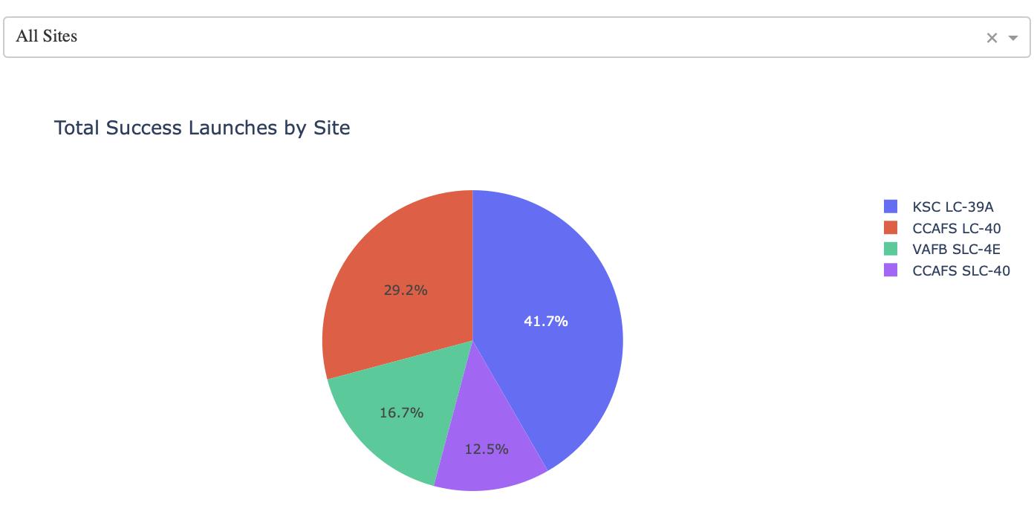
Launch Success Count by Site
Majority of successful launches at KSC LC-39A site
Minority of successful launches at CCAFS SLC-40 site

Slide 40
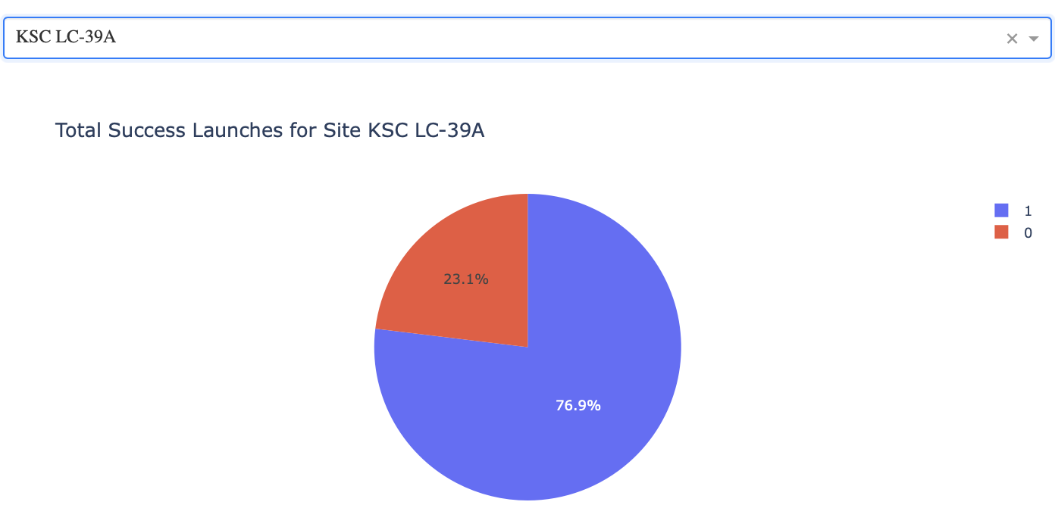
Launch Site with Highest Launch Success Ratio
With 76.9% of launch success rate (blue), KSC LC-39A site has the largest launch success ratio of all sites

Slide 41
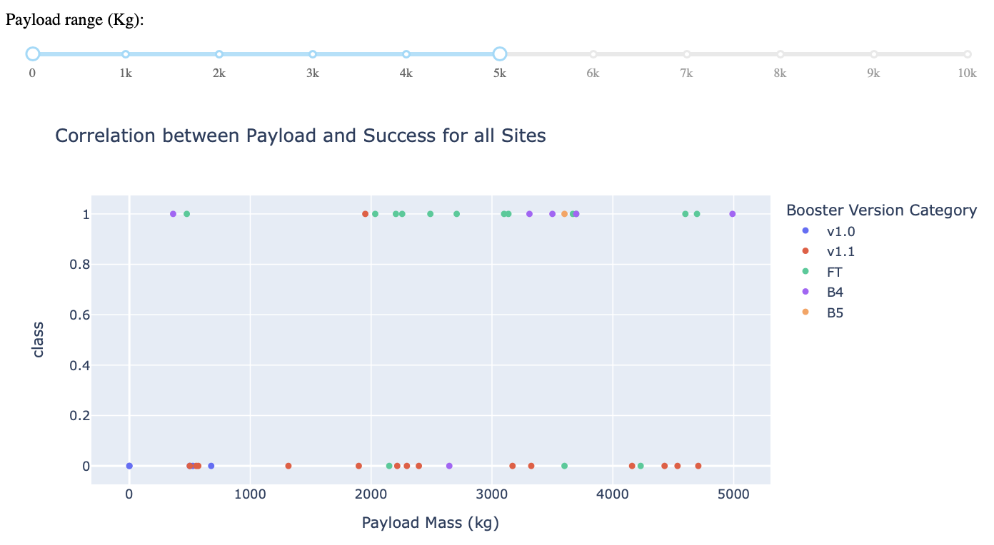
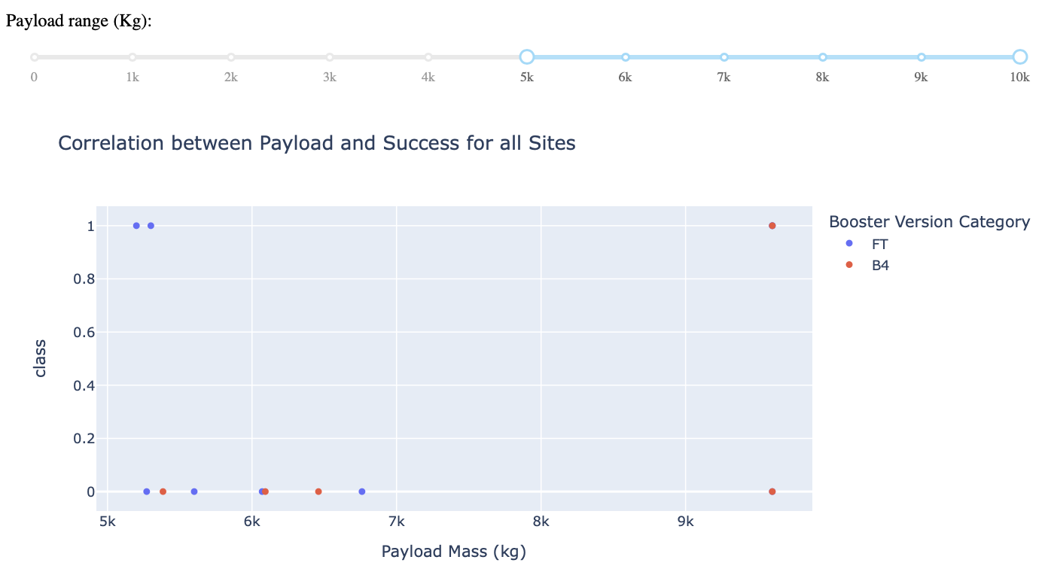
Payload Mass vs Launch Outcome for All Sites
Payload Mass range (0kg - 5’000kg)
Payload Mass range (5’000kg - 10’000kg)
Boosters v1.0, v1.1, FT, B4 and B5 are used for carrying lightweight payload. The most successful candidate (class = 1) is the FT booster (green).
Boosters FT and B4 carry the highest payload mass with only 2 successful landings for FT (blue) and 1 for B4 (red) on the specified range.

Slide 42

Section 5

Slide 43
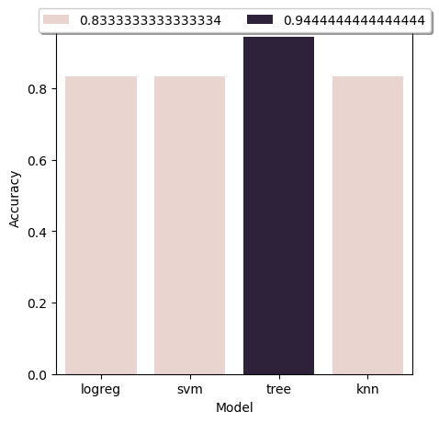
Classification Accuracy
The model with highest accuracy (94%) is the decision tree model.
All other models have accuracy of 83%.

Slide 44

Confusion Matrix of Best Performing Model
Decision Tree Confusion Matrix (test_size = 18 samples)
0 FN
1 FP
Model performs well except for 1 test sample (FP).

Slide 45
Conclusions
Key aspects for the success of SpaceX F9 launching and landing are listed below:
Payload mass and success rate increased throughout the years from 2010 to 2020
Best performing orbit type is the SS0 orbit
Launch sites are located close to the equator and close to coastlines
Best performing launch site is KSC LC-39A with 76.9% success rate
Best performing booster version is the FT for lightweight payload, whereas the success rate for heavy payload is low for both B4 and FT
Falcon 9 launchers can be classified using a decision tree with 94% accuracy score

Slide 46
Appendix
Python code snippets, SQL queries, charts, Notebook outputs, or data sets

Slide 47


